Slide 1
Supplier Instructions for Allegion PRISM 8Ds
Allegion
Updated 1-2020

Slide 2
General Instructions for Supplier to work with Allegion’s PRISM 8D system
What is PRISM and how do I access it?
D0-only 8Ds
Full 8Ds

Slide 3
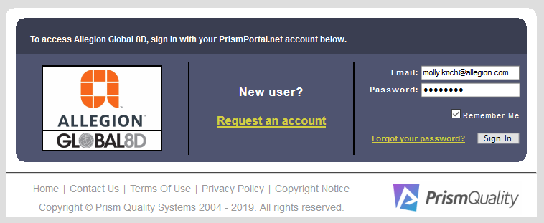
What is PRISM?
PRISM is a web-based software that Allegion is using to document findings / issues / spills within our supply base and track associated problem solving efforts using the standard 8D problem solving methodology.

Slide 4
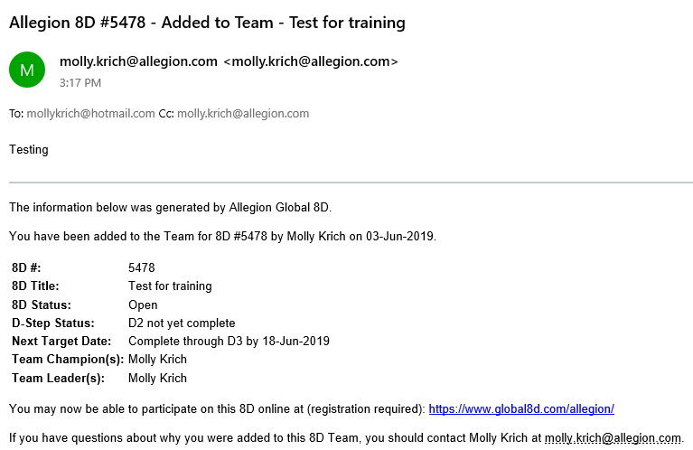
How do I access PRISM?
  Suppliers can only be issued PRISM accounts and receive access if:
    You are assigned to an 8D team
    You are assigned to an 8D team with a personalized company email address
  Example email you will receive when you have been added to a team

Slide 5
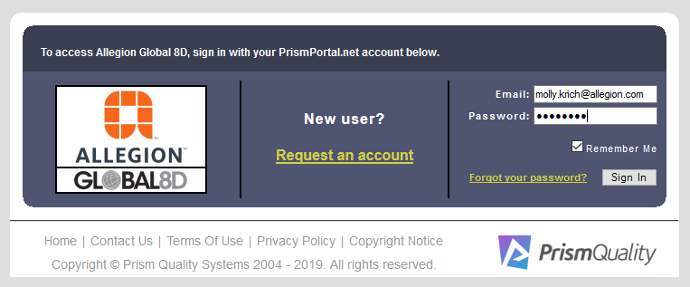
How do I access PRISM?
Sign on screen: www.global8d.com/allegion
If you enter the site for the first time using the web address (instead of a link within an email), then you must request access.
Complete the registration process using the same email address where you received your notification email or that you know is associated with an 8D, and if you have been assigned to a team (via that email address), you will be given access to Allegion’s PRISM system immediately.

Slide 6
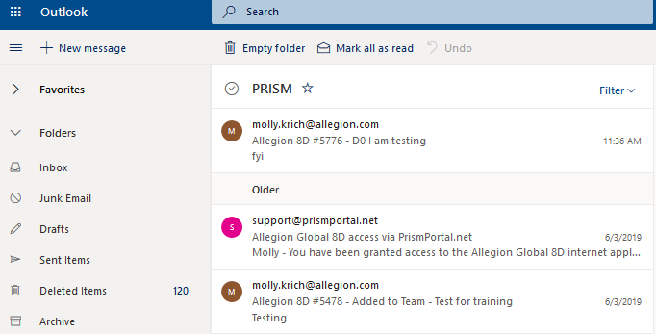
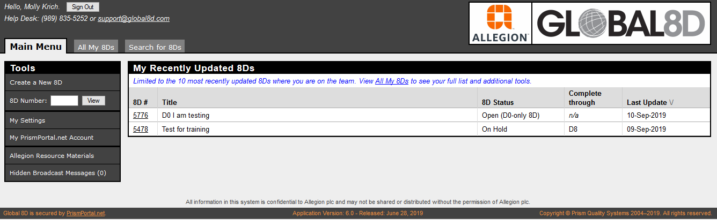
How do I access PRISM?
All notification emails from the PRISM system will show as though they are from an Allegion contact or from support@prismportal.net
When you sign into PRISM, you will see the screen below
It contains only the 8Ds where you are a member of the team

Slide 7
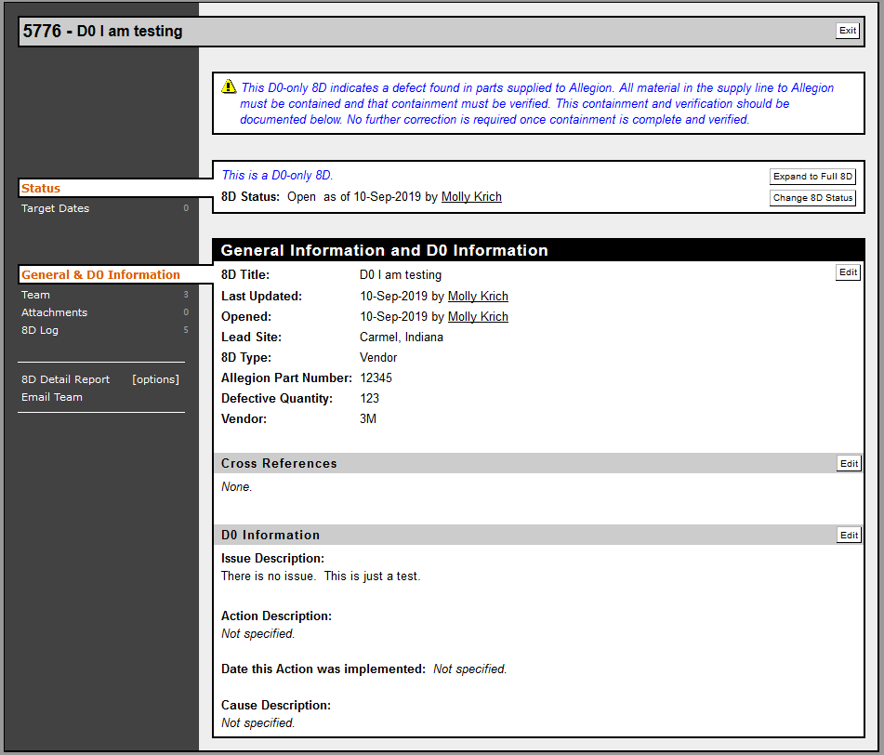
D0-only 8Ds
  No formal problem solving required.
  Vendors are responsible to contain suspect stock in house and in SOMI, ensuring NO additional defects are shipped to Allegion.
Document Containment in ‘Attachments’ and / or in the ‘Action Description’.
Click ‘Edit’ to open editable form, and then be sure to click ‘Save and Return’ once you have completed your changes (see screen shots on next slide).

Slide 8
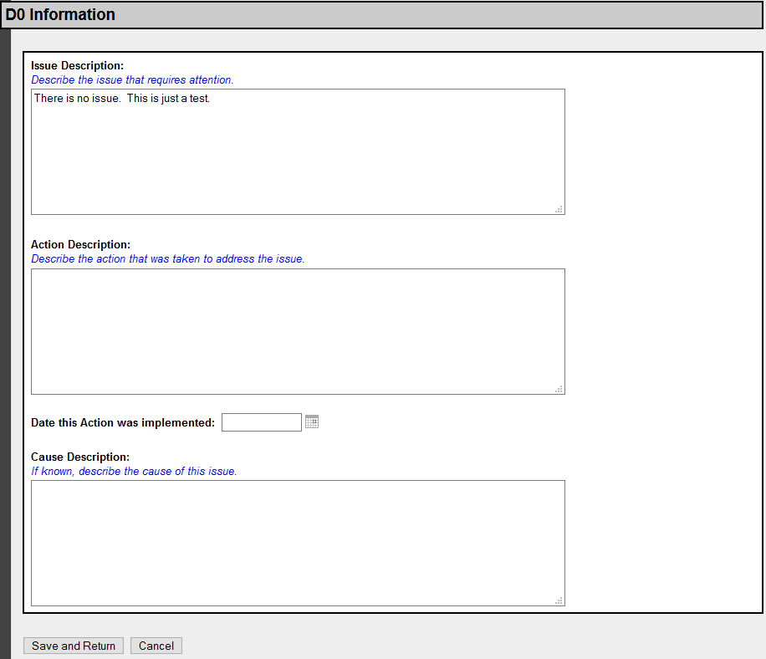
D0-only 8Ds
Reminder:
Vendors are responsible to contain stock in house and in SOMI, ensuring NO additional defects are received by Allegion.
Adding Action Description
Enter text in appropriate boxes.
Click ‘Save and Return’ when complete.
Note: This format (‘Edit’ – ‘Save and Return’) will be the same or similar in all PRISM 8D updates.

Slide 9
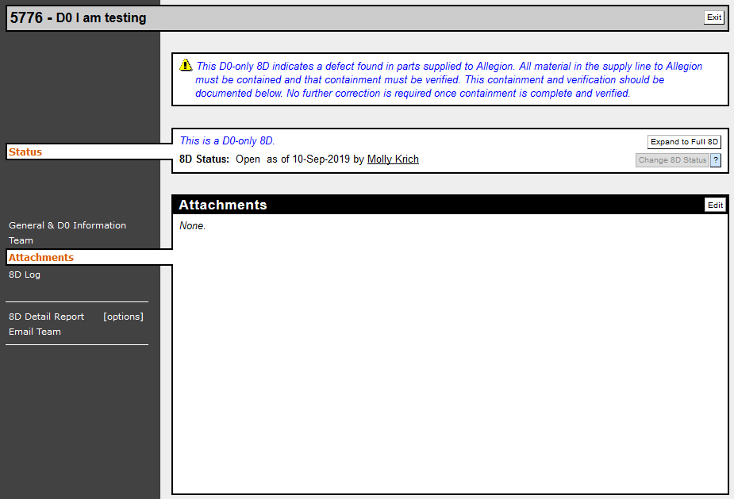
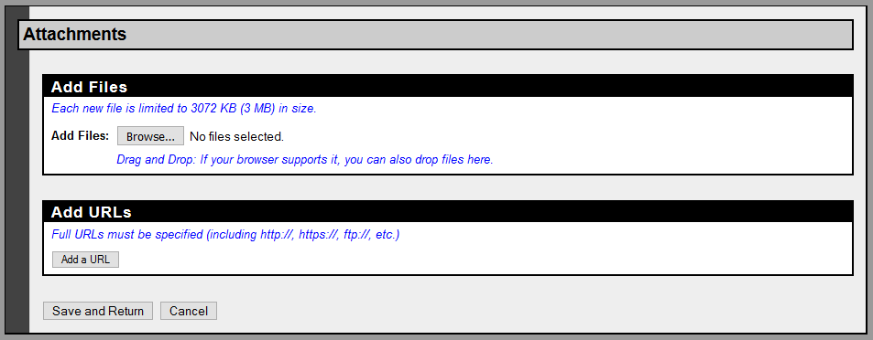
D0-only 8Ds
Reminder:
Vendors are responsible to contain stock in house and in SOMI, ensuring NO additional defects are received by Allegion.
Adding Attachments
Click ‘Edit’ to open Attachments screen as shown below. All format types are accepted.
Click ‘Save and Return’ when all attachments have been uploaded.

Slide 10
Full 8Ds
  Allegion is responsible for correct and detailed information in D0 – D2.
  Vendors are responsible for completing and documenting details in each step – D3 thru D8.
  8D must be marked “Complete through D8” by changing the 8D’s D-Step Status.
    This must be done within 60 days of the date when the status was changed to “Complete through D2” for the 8D to be on time.
    This requirement is also stated in Allegion’s Global Supplier Requirements Manual under the Quality – Non-conforming material section.
    Global Supplier Requirements Manual on Allegion's Supplier Portal
  Pictures and files can all be attached to the system.
  As each step is completed, the vendor should update the D-Step status accordingly so it is always clear where the 8D is currently at in the process.

Slide 11
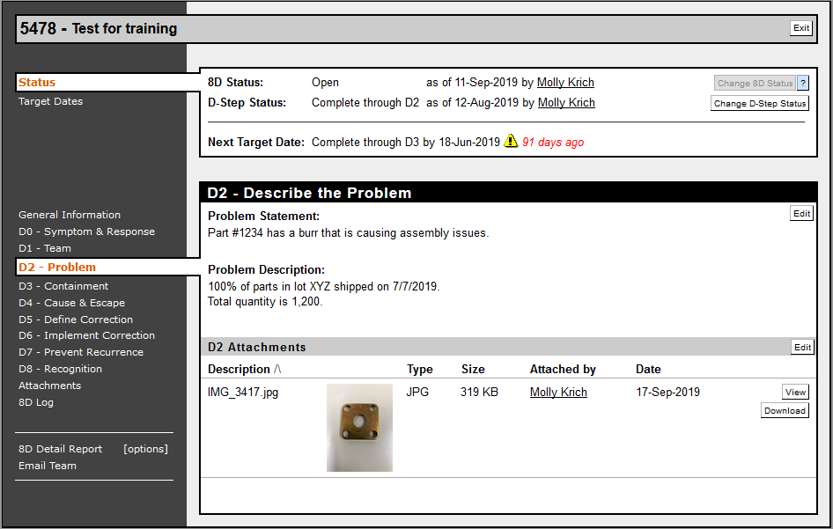
Full 8Ds
Allegion information – D0 thru D2
Click ‘D1’ to see the people currently assigned to the 8D team. If supplier wants different or additional people on team, contact the Allegion person who issued the 8D
Click ‘D2’ to see the details of the problem Allegion has found.

Slide 12
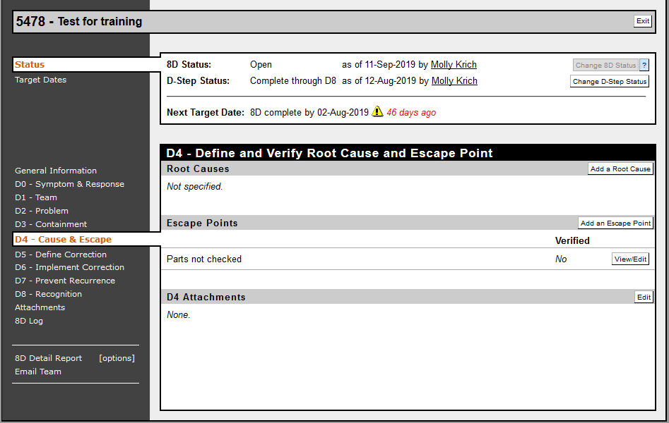
Full 8Ds
Supplier updates sections D3 – D8 accordingly by clicking on the step that you want to update in the left hand menu

Slide 13
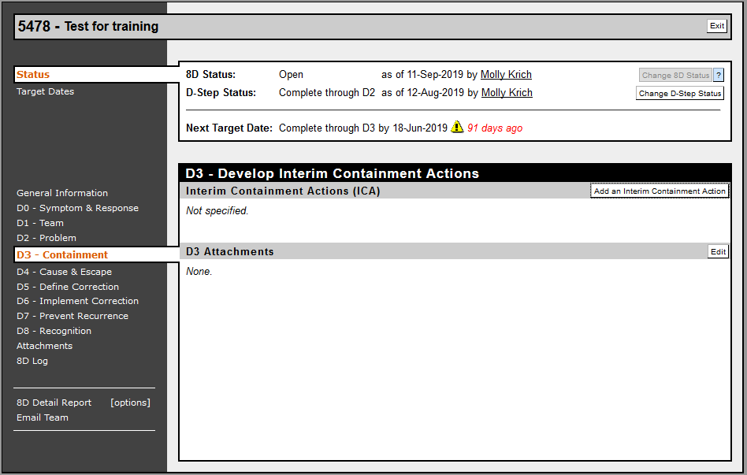
Full 8Ds
D3 - Containment must occur for full 8Ds.
Click ‘’Add an Interim Containment Action’

Slide 14
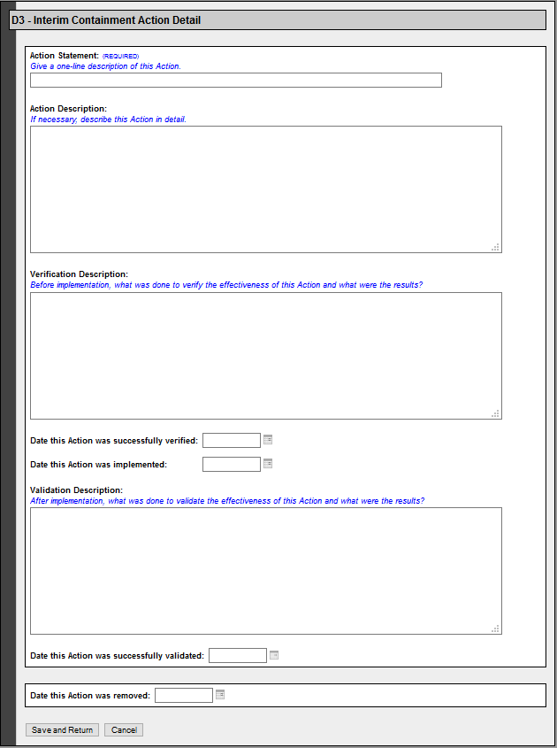
Full 8Ds
Document all containment actions.
Details such as quantity, methods and dates are required.

Slide 15
Full 8Ds
D4 – D6: At least one entry for BOTH the root cause of the issue AND the reason the defects escaped your facility are required for steps D4 – D6.
Click ‘’Add a Root Cause’ or ‘Add an Escape Point’ to open editable forms.
Previous entries can also be viewed in more detail or edited by clicking ‘View/Edit’.

Slide 16
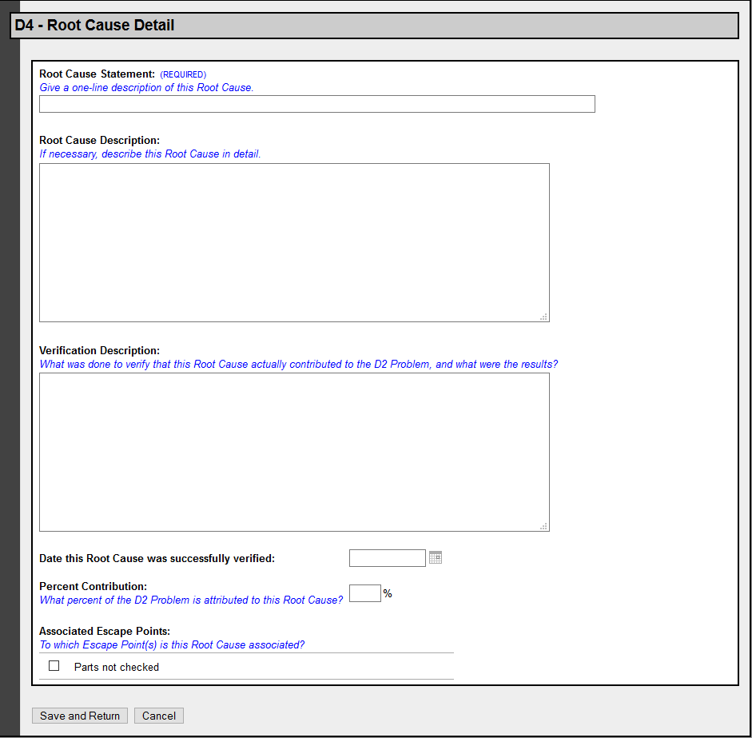
Full 8Ds
Once in the editable form, add as much detail as possible for each root cause and each cause of escape.
Be sure to click ‘Save and Return’ when updates are complete.
NOTE – Dates are required for all implementation and validation activities.

Slide 17
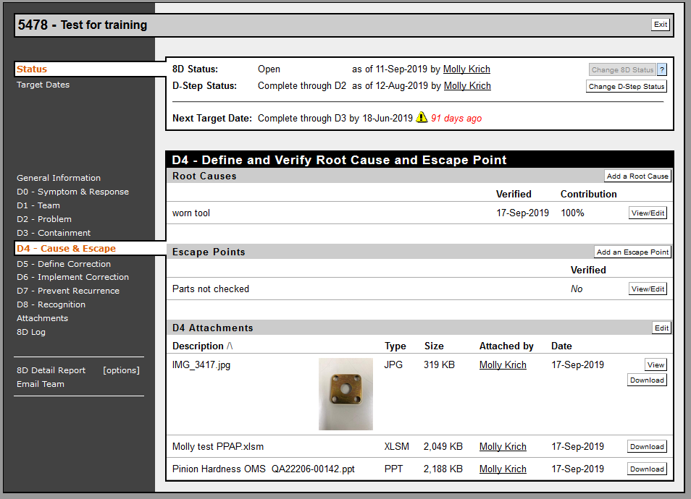
Full 8Ds
Add attachments as needed
Attachments can be added within each D-Step or within the Attachments sections in the left hand menu.
These can be pictures, documents, control plans, etc.
Anything to help explain and SHOW the corrective actions taken, and any document type can be added.

Slide 18
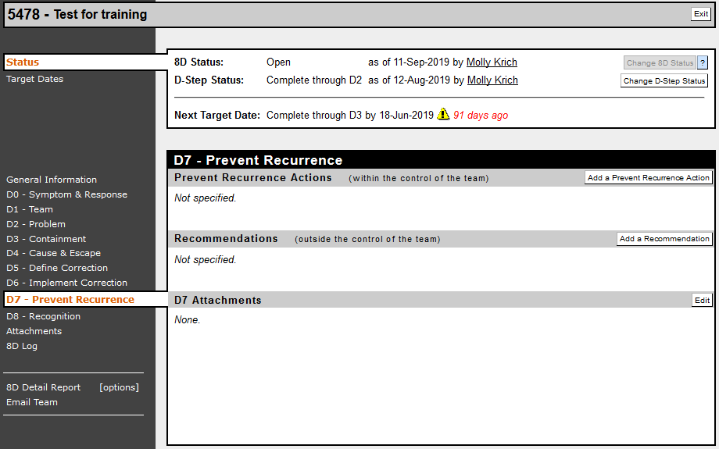
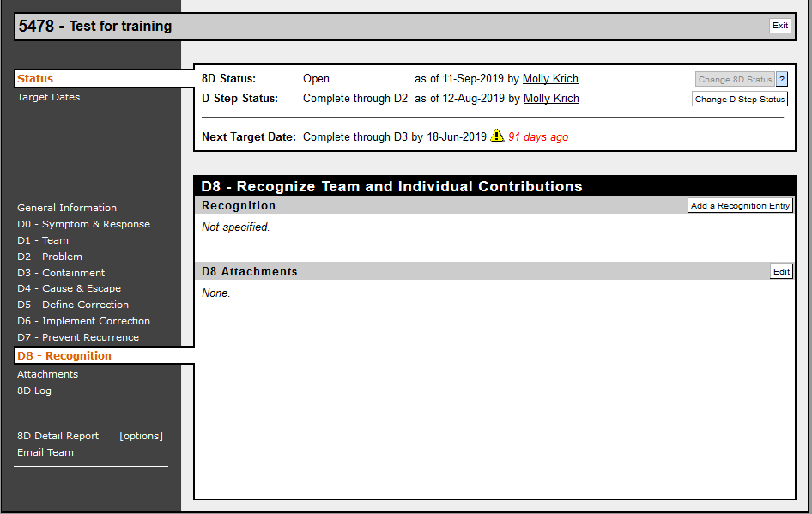
Full 8Ds
Do not forget D7 and D8.

Slide 19
Full 8Ds
Update D-Step Status after each step is completed to always show current status of the 8D.
Click ‘Change D-Step Status’

Slide 20
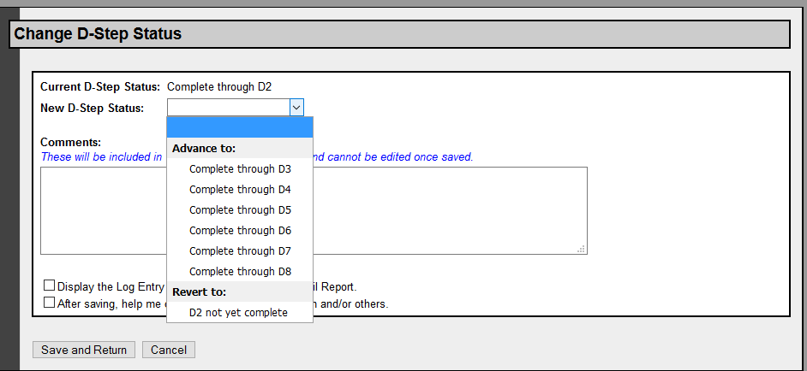
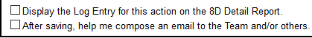
Full 8Ds
From the dropdown, select the appropriate status based on the current action take and information loaded into the 8D
You also have option boxes to utilize:
Display this action in the 8D Detail Report (recommended)
Use PRISM to send an email to the entire 8D team (recommended, ESPECIALLY when D-step status is updated to ‘Complete through D8’
And as always – ‘Save and Return’

Slide 21
Full 8Ds
  Once the supplier has updated the D-Step status to ‘Complete thru D8’, it becomes Allegion’s responsibility to review the information within the 8D and either mark it complete or ask the supplier for more information.

Slide 22
Full 8Ds
NOTE – Email team functionality
Click ‘Email Team’ and the PRISM system will automatically start an email to the entire team based on the 8D.
The email can also be stored within PRISM and shown on the 8D log for record keeping purposes.

Slide 23
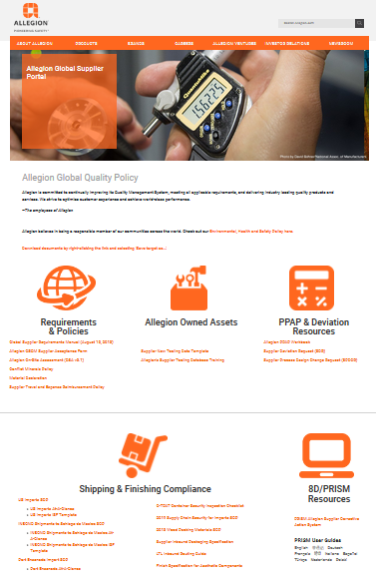
Resources – User Guides on Supplier Portal
Allegion’s Supplier Portal Link
https://www.allegion.com/corp/en/footer/policies/supplier-portal.html
Notes:
At the supplier web portal, in English, Chinese, German, French, Hindi, Italian, Spanish and Turkish
The guides show screen shots with explanations in the native languages

Slide 24
Current Allegion PRISM Administrators
Mike Bellis
(317) 703-5412 michael.bellis@allegion.com
Molly Krich
(805) 915-9959 molly.krich@allegion.com

Slide 25
Rev 2 – 9/17/2019 converted from .pdf with updated screen shots
Rec 3 – 1/14/2020 updated ALLE administrator contact info updated supplier portal information

