Slide 1
PRISM PPAP
Supplier Training
Allegion Supplier Quality
September 2026

Slide 2

Table of Contents
PRISM PPAP Training
Overview
Access
PRISM PPAP Terminology
Home Page & Navigation
Binders, Packages, & Elements
PPAP Package Process
Access (within PRISM)
Questions?

Slide 3
Overview
What is it?
Online Portal that allows Allegion users & Suppliers to process PPAP’s together and in real time.
Purpose / Benefits:
  Optimize the process by enhancing communication and accountability.
  Improve visibility of PPAP requirements and status element by element.
  Decrease the time it takes to start and complete PPAP’s.

Slide 4
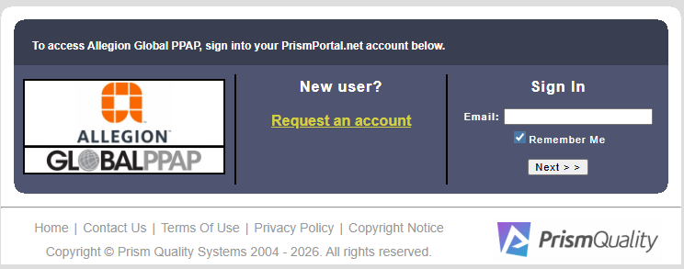
Access
How to Access PRISM PPAP
Access the PRISM PPAP Link: PrismPortal.net
For New Users: Select – “Request an account”
For Returning Users: Sign in with your associated email address.
NOTE – Existing PRISM 8D users will need to ‘Request an account’ to start using PRISM PPAP module.

Slide 5
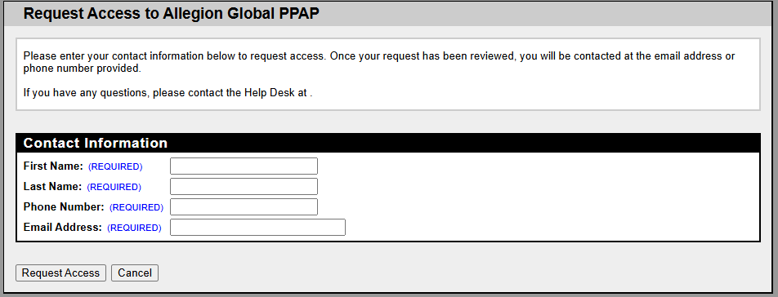
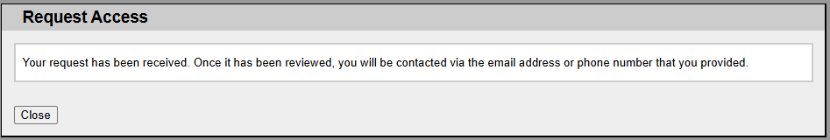
Access
Requesting a New Account
Fill out all fields as shown.
Group email address are not allowed.
Click on “Request Access” and following the next prompts to finish access.

Slide 6
PRISM PPAP Terminology
Definitions
What is a Binder?
  Repository for all PPAPs for a specific part / part family and supplier combination.
What is a Package?
  PPAP Plan as required by Allegion Quality.
What are Elements?
  Requirements within a PPAP package dependent on the PPAP level.
What is the SQE Team?
  Allegion Quality Team destinated to review and process PPAP packages.
What is the Supplier Team?
  Team that will be responsible for uploading and completing PPAP requirements.

Slide 7
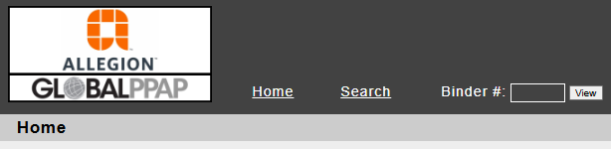
Home Page & Navigation
Home Page
Main Menu
  Home – Page where all PPAP packages in process or recently approved packages can be found.
  Search – Search for all PPAP’s ever assigned to the supplier.
  Binder – Quickly navigate to a known Binder number.
Different Sections found on the Home Page
Mandatory step prior to starting PPAP’s. Contact your Allegion contact if there are any questions.
PPAP Packages in process that are not yet dispositioned.
Displays recently Approved PPAP’s. Interim Approved Packages will not show here.

Slide 8
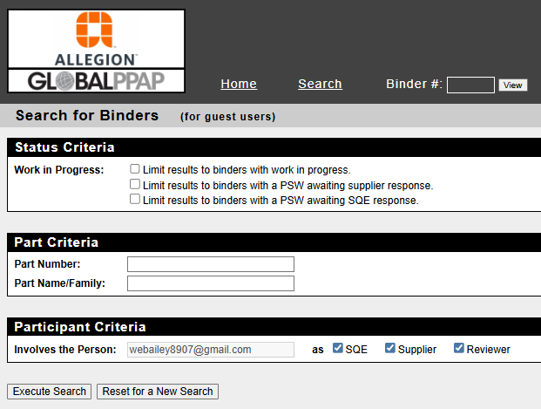

Home Page & Navigation
Search Function
If you have the Binder Number, you can navigate directly to it; otherwise, use the search function to find the specific PPAPs you are looking for.

Slide 9
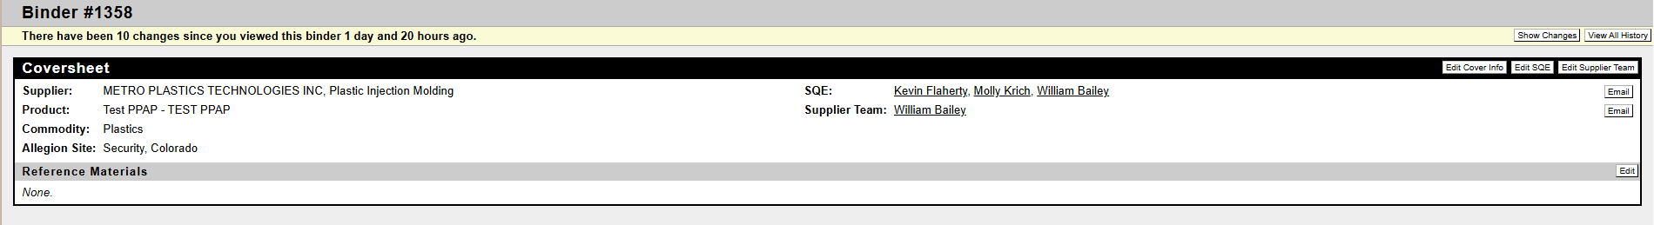
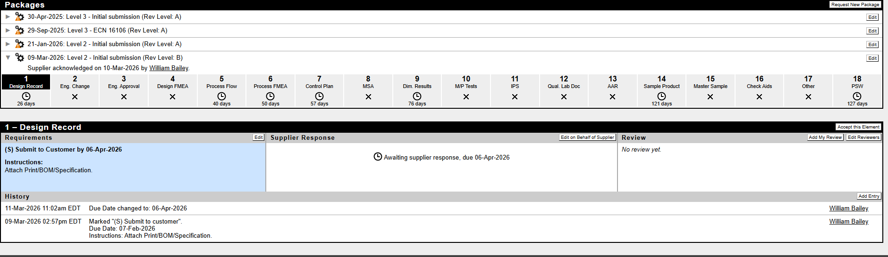
Binders, Packages, & Elements
Package View
Supplier Name Will Be Here
ALLE QA team members will be here
Supplier team members will be here
Allegion & Supplier Team Names
Binder Data
List of all PPAP Packages in the Binder
Required Elements with Due Dates

Slide 10
Binders, Packages, & Elements
Package View
Supplier Name Will Be Here
ALLE QA team members will be here
Supplier team members will be here
Supplier Documentation will be submitted here
Engineering Review Tasks will be here
Element Instructions
All Element History will be stored here, including all attachments

Slide 11
PPAP Package Process
PPAP Steps
Step 1: Supplier Acknowledgment
  Once a Package is assigned to the supplier, it MUST be acknowledged. Nothing within the PPAP can be changed at this point in time. If elements need to be altered, it can be done after the package is acknowledged.
  Note: Goal is to acknowledge PPAPs within 3 business days of receipt of PPAP request email notification. PPAP is frozen until package is acknowledged.
Step 2: Upload Required Documentation per Element
  As documents are ready, please upload all data in their respective element, paying attention to the due dates.
  There is a max 10MB file size per attachment. If needed, consolidate files or break up attachments.
Step 3: Complete and Sign the PSW
  Once all required elements have documents uploaded, complete and sign the PSW under element 18.

Slide 12
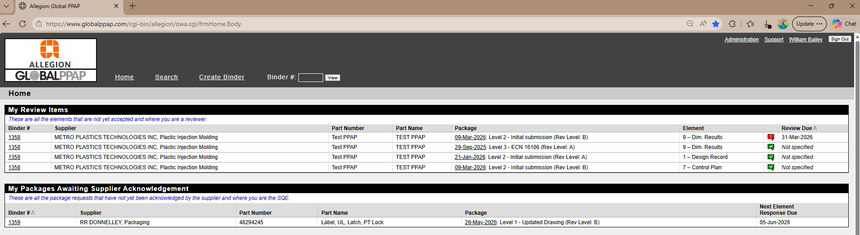
Access (within PRISM)
How to Toggle between PRISM PPAP and PRISM 8D
It is possible to move between PRISM accounts (8D and PPAP), as shown in the video below:
Supplier Name Will Be Here
Supplier Name Will Be Here
Supplier Name Will Be Here
Supplier Name Will Be Here
Supplier Name Will Be Here
Click on the Video!

Slide 13

Questions?
Q&A
Contact Information:
  For any questions or concerns regarding PRISM PPAP, or if additional training is needed, please contact the following people:
  William Bailey (William.Bailey@allegion.com)
  Molly Krich (Molly.Krich@allegion.com)

