Slide 1
PRISM PPAP Training
Overview
Molly Krich & Will Bailey
April 2026

Slide 2

Table of Contents
PRISM PPAP Training
Overview
Access
PRISM PPAP Terminology
Home Page & Navigation
Binders, Packages, & Elements
PPAP Process Overview
Windchill & PRISM Connection
PowerBI Link
Appendix
Questions?

Slide 3
Overview
What is it?
Online Portal that allows Allegion users & Suppliers to process PPAP’s together and in real time.
Purpose / Benefits:
  Optimize the process by enhancing communication and accountability.
  Improve visibility of PPAP requirements and status element by element.
  Decrease the time it takes to start and complete PPAP’s.

Slide 4
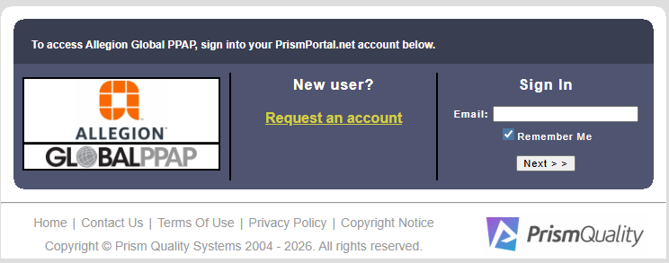
Access
How to Access PRISM PPAP
Access the PRISM PPAP Link: PrismPortal.net
For New Users: Select – “Request an account”
For Returning Users: Sign in with your associated email address.
NOTE – Existing PRISM 8D users will need to ‘Request an account’ to start using PRISM PPAP module.

Slide 5
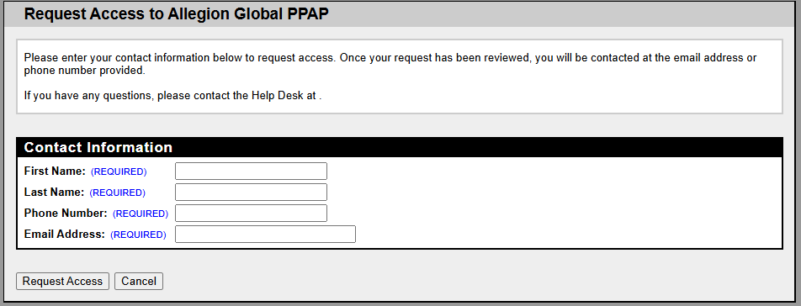
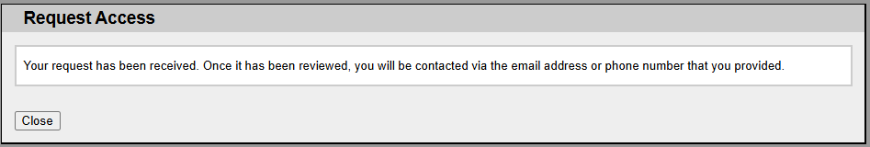
Access
Requesting a New Account
Fill out all fields as shown.
Group email address are not allowed.
Click on “Request Access”. The request will go to Allegion Admins for review. You will receive an email once access has been granted.
If access has not been granted within 24 – 48 hours, please contact William.Bailey@allegion.com or Molly.Krich@allegion.com

Slide 6
PRISM PPAP Terminology
Definitions
What is a Binder?
  Repository for all PPAPs for a specific part / part family and supplier combination.
What is a Package?
  PPAP Plan as required by Allegion Quality.
What are Elements?
  Requirements within a PPAP package dependent on the PPAP level.
What is the SQE Team?
  Allegion Quality Team destinated to review and process PPAP packages.
What is the Supplier Team?
  Team that will be responsible for uploading and completing PPAP requirements.

Slide 7
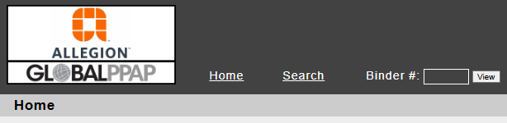
Home Page & Navigation
Home Page
Main Menu
  Home – Page where all PPAP packages in process or recently approved packages can be found.
  Search – Search for all PPAP’s ever assigned to the supplier.
  Binder – Quickly navigate to a known Binder number.
Different Sections found on the Home Page
Mandatory step prior to starting PPAP’s. Contact your Allegion contact if there are any questions.
PPAP Packages in process that are not yet dispositioned.
Displays recently Approved PPAP’s. Interim Approved Packages will not show here.

Slide 8
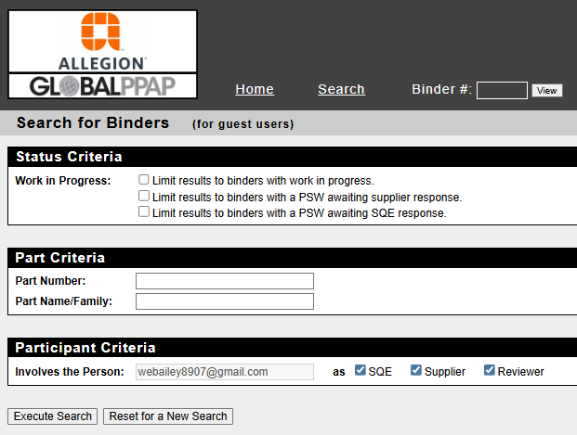

Home Page & Navigation
Search Function
If you have the Binder Number, you can navigate directly to it; otherwise, use the search function to find the specific PPAPs you are looking for.

Slide 9
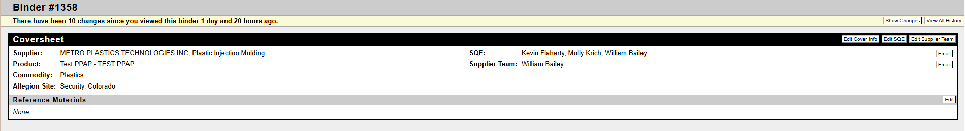
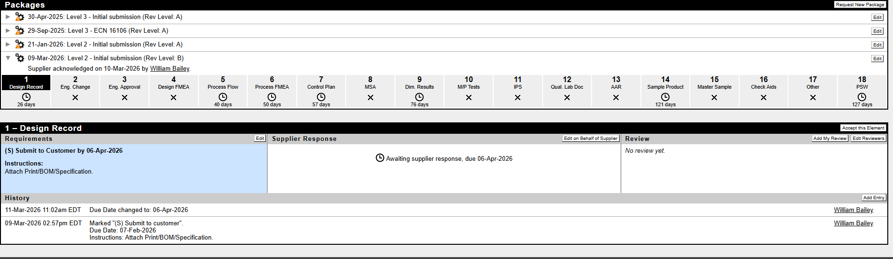
Binders, Packages, & Elements
Package View
Allegion & Supplier Team Names
Binder Data
List of all PPAP Packages in the Binder
Required Elements with Due Dates

Slide 10
Binders, Packages, & Elements
Package View
Supplier Documentation will be submitted here
Engineering Review Tasks will be here
Element Instructions
All Element History will be stored here, including all attachments

Slide 11
PPAP Package Process
Definitions
What is a Binder?
  Repository for all PPAPs for a specific part / part family and supplier combination.
What is a Package?
  PPAP Plan as required by Allegion Quality.
What are Elements?
  Requirements within a PPAP package dependent on the PPAP level.
What is the SQE Team?
  Allegion Quality Team destinated to review and process PPAP packages.
What is the Supplier Team?
  Team that will be responsible for uploading and completing PPAP requirements.

Slide 12
Appendix

Slide 13
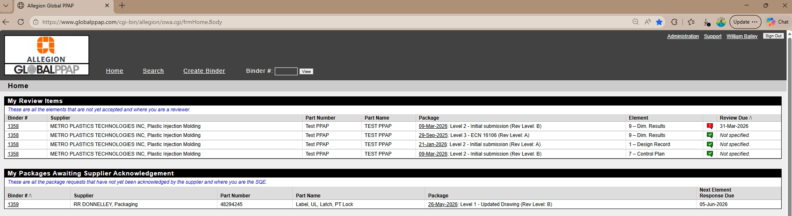
Access (within PRISM)
How to Toggle between PRISM PPAP and PRISM 8D
If needed, it is possible to move between the PRISM accounts, as shown in the video below:
Click on the Video!

Slide 14
PRISM PPAP
Valuable Information
All Allegion employees with access to PRISM PPAP can view PPAP’s.
It is not possible to edit or make changes to binders and packages unless you are on the SQE Team.
Only those in the PRISM SQE role can create PPAP binders and packages.
Suppliers can add as many people as they need to.

Slide 15

Questions?
Q&A

